Slide 1
Agency Overview
Rob Siedlecki, Acting Secretary

Slide 3
Rob Siedlecki Jr., Acting Secretary of Social and Rehabilitation Services (SRS)
Rob Siedlecki has more than 15 years of public and private sector leadership experience at the local, state and federal levels. He worked for four years in the federal government's Administration for Children and Families which oversees more than 60 programs, including Head Start, the Healthy Marriage Initiative, runaway and homeless youth programs, and the Temporary Assistance for Needy Families (TANF) program. He served as chief of staff for the Florida Department of Health which has 17,000 employees and an annual budget of nearly three-billion dollars.

Slide 4
Organization
 | Acting Secretary Rob Siedlecki
General Counsel Bob Corkins |  | Chief of Staff Jeff Kahrs
Legislative director Gary Haulmark | Director of Public Policy Michelle Schroeder | Communications Director Bill Miskell
Disability and Behavioral Health Services
Ray Dalton, Deputy Secretary
Addiction and Prevention Services
Mental Health Services
State Mental Health Hospital
Community Supports and Services
State MR/DD Hospitals
Administration
Chief Financial Officer
Laura Howard Deputy Secretary
Information Technology Kathy Cox Acting Chief Information Officer
Human Resources Robbie Berry, Director
Strategic Development
Kelly Peak, Director
Integrated Service Delivery
_________, Deputy Secretary
Children and Family Services
Economic and Employment Support
Rehabilitation Services
Child Support Enforcement
Regional Offices

Slide 5
SRS Leadership Team – Contact Information
Rob Siedlecki Acting Secretary 296-3271 | Michelle Schroeder Public Policy Director 291-3629
Jeff Kahrs Chief of Staff 296-3271 | Bill Miskell Communications Director 296-3271
Bob Corkins General Counsel 296-3967 | Gary Haulmark Legislative Director 296-3271

Slide 8
Expenditures and Persons Served By Program
 | SFY 2011 GBR |  | SFY 2012 GBR
SRS Program | Total Program Expenditures | People Served | Total Program Expenditures | People Served
Addiction and Prevention Services | 46,126,718 | 284,270 | 48,052,591 | 295,259
Mental Health | 332,141,594 | 105,836 | 326,657,585 | 88,554
Community Supports and Services | 555,445,668 | 44,674 | 554,086,726 | 42,439
Children and Family Services | 196,053,123 | 76,237 | 205,852,310 | 76,656
Economic and Employment Support | 222,285,712 | 531,707 | 187,380,976 | 578,436
Rehabilitation Services | 47,536,160 | 69,186 | 47,286,360 | 70,610
Child Support Enforcement | 28,055,085 | 125,848 | 29,404,640 | 125,260
State Hospitals
Mental Health | 95,098,739 | 715 | 96,565,928 | 716
Developmentally Disabled | 54,505,193 | 345 | 54,606,965 | 330
Note: People served could be duplicated between programs.

Slide 9
Summary of SRS, Children’s Cabinet, and State Hospital Budget Adjustments
The Governor added funding for the increases in all of the entitlement caseload programs
State General Funds were added in the Governor’s budget to replace the loss of federal funds because of lower than anticipated extended FMAP in FY 2011 and decline in the base FMAP in 2012
The Governor added State General Funds to replace fee fund and maintain the current level of service in the Home and Community Based Service Waivers
Overall the budgets were reduced approximately 1.5 percent in FY 2012 over FY 2011
Reductions were made to the Developmental Disabilities Day and Residential Grants, Kansas Early Head Start Program, General Assistance Program, and Mental Health State Aid Grants.

Slide 10
Summary of SRS, Children’s Cabinet, and State Hospital Budget Adjustments
Because of declining tobacco revenues, Children’s Initiative Fund reductions occurred in Family Centered Systems of Care, Children’s Cabinet Early childhood Block Grant, Children’s Cabinet Accountability Fund and Children’s Cabinet Smart Start in FY 2011
Salary reductions and elimination of vacant positions were made in SRS, Osawatomie State Hospital, and Rainbow Mental Health Facility.
Increased Expanded Lottery Act Revenue will provide additional funding for the Problem Gambling and Addictions Grant Fund
Savings was captured in FY 2012 to begin the closure of KNI
$6.0 million Children’s Initiative Funds were added for the new Reading Roadmap Program
Children’s Initiative Fund reductions occurred in Children’s Cabinet Smart Start and CIF funding was discontinued for the Family Centered System of Care

Slide 11
Addiction and Prevention Services
Partnering to Promote Prevention and Recovery in Kansas Communities
Substance Use Disorders
Prevention
Reduce underage drinking
Reduce underage access to tobacco (Synar amendment)
13 Regional prevention Centers work
Treatment
Managed Care
Block grant and Medicaid funds
4th time DUI program (KDOC MOU)
Problem and Pathological Gambling
Problem Gambling and Addiction Fund
Problem Gambling Treatment
“Other Addiction” Services gaps

Slide 12
Mental Health Services
Treatment and support for Kansans with mental illness that ensure they experience recovery and live successful lives in the community
Community Mental Health Center Grants
Support CMHC infrastructure (e.g., 24 hour crisis response)
Serve people without the means to pay for treatment
Medicaid Mental Health Managed Care
Serve All Kansans on Medicaid
HCBS Waiver for Children with a serious emotional disturbance
In-patient and Residential Treatment
Psychiatric Residential Treatment Facilities: Residential treatment for children with a serious emotional disturbance
Community Hospitals: An alternative to state mental health hospitals for all children and some adults
Nursing Facilities for Mental Health
Residential treatment for adults with severe and persistent mental illness
Consumer run and consumer support groups
Consumer Run Organizations and Consumer Advisory Council
NAMI and Keys for Networking

Slide 13
State Mental Health Hospitals
Inpatient psychiatric treatment for Kansans experiencing severe mental health symptoms determined a danger to themselves or others, and forensic mental health services
Osawatomie State Hospital
Provides acute inpatient treatment for adults with mental illness.
SPTP Transition Program
Rainbow Mental Health Facility
Provides primarily short-term, acute inpatient treatment for adults with mental illness
Larned State Hospital
Psychiatric Services Program - provides inpatient treatment to children, adolescents and adults
State Security Program - provides evaluation, competency restoration and inpatient treatment for forensic patients
Sex Predator Treatment Program

Slide 14
Community Supports and Services
Provide resources and support to help Kansans with disabilities live self-directed lives in their community
Transition from facilities to the community
Money Follows the Person grant
Medicaid waivers for home and community based services
Physical Disability Waiver
Serves individuals age 16-65 who would otherwise require institutionalization in a nursing facility
Mental Retardation/Developmental Disability Waiver
Provides community based services for individuals age 5 and up who otherwise would be eligible for placement in an intermediate care facility
Traumatic Brain Injury Waiver
Serves individuals age 16-64 who have a traumatically acquired, non-degenerative, structural brain injury
Technology Assisted Waiver
This program assists children, age 0-21 years who are chronically ill and medically fragile and dependent upon a life-sustaining medical device to compensate for loss of a vital body function
Autism Waiver
An early, intensive intervention service targeting children up to age 5 who would otherwise be served in a state mental health hospital

Slide 15
Waiver Waiting Lists as of January 1, 2011
 |  | Cost to Eliminate list *
 | People on Waiting List | All Funds | SGF
Physical Disability (PD) Waiver | 2,771 | $ 56,894,172 | $ 24,214,160
Developmental Disability (DD) Waiver ** | 3,391 | $ 114,364,653 | $ 48,673,596
Autism Waiver | 264 | $ 4,976,928 | $ 2,118,181
Traumatic Brain Injury (TBI) Waiver |  | No wait list
Serious Emotional Disturbance (SED) Waiver |  | No wait list
Total | 6,426 | $ 176,235,753 | $ 75,005,937
* The cost to eliminate the waiting list is based on the assumption the list is eliminated all at once on the first day of the fiscal year.
** The total includes both individuals who are unserved (2,383) and underserved who are waiting for additional services ( 1,008).

Slide 16
Private/Public Intermediate Care Facilities
Residences for Kansans with disabilities who require intensive supports
State Mental Retardation/Developmental Disability Hospitals
Kansas Neurological Institute
98% of residents are severely to profoundly mentally retarded and require intensive medical supports
Parsons State Hospital and Training Center
86% of residents present with behavioral challenges or symptoms of emotional disturbance and require more intensive supports
Private Intermediate Care Facilities (ICFs/MR)
Funded by Medicaid, these facilities serve individuals who need continuous, intensive services.
They work closely with community developmental disability organizations to arrange supports and services when the individual is ready to live more independently

Slide 17
Children and Family Services
Protect children from abuse and neglect, provide in-home services to preserve families, and seek safe, permanent homes for children
Prevention Efforts
Grants for community services to avoid abuse and neglect and promote good parenting
Child Protective Services
Investigate reports of alleged abuse and neglect
Family Preservation Services
Intensive in-home services that seek to keep families together
Permanency
Foster care, reintegration and adoption services. After court-ordered removal, 95% of children are placed in a family-like setting. Assistance may be offered for adoption or permanent custodianship.

Slide 18
Economic and Employment Support
Promote self-sufficiency by assisting individuals and families to prepare for and maintain gainful employment
Support Employment
Temporary Assistance for Families
Provides training and work experience for participants and up to 60 months of cash assistance.
Child Care Assistance
Provides support to working families who need childcare
Provide Economic Assistance
General Assistance/MediKan
Provides cash and medical assistance to disabled Kansans waiting for federal disability determination
Food Stamps
Helps low-income persons buy food with an electronic benefit card
Low Income Energy Assistance Program
Provides assistance to keep homes heated and helps weatherize dwellings
Food Distribution Programs
Provide foodstuffs to charitable institutions, soup kitchens and, in emergencies, directly to consumers
Protect Vulnerable Adults
Adult Protective Services
Investigate reports of alleged abuse, neglect, and exploitation

Slide 19
Rehabilitation Services
Support Kansans with disabilities in gaining and keeping employment,
and determine medical eligibility for federal disability programs
Vocational Counseling and Guidance
Education and Training
Job Placement and Supported Employment
Contract for services that support people seeking employment
Disability Determination Services
Determine medical eligibility for Social Security Disability Insurance and Supplementary Security Income

Slide 20
Child Support Enforcement
Promote self-sufficiency by facilitating receipt of child support payments
Establish paternity
Establish and modify financial and medical support orders
Collect and disburse support payments
Enforce income withholding and court actions

Slide 21
Upcoming Initiatives
Healthy Marriage Initiative
Reviewing disincentives to marriage in existing programs
Fatherhood Initiative
Outreach to Faith-Based Community Organizations

Slide 22
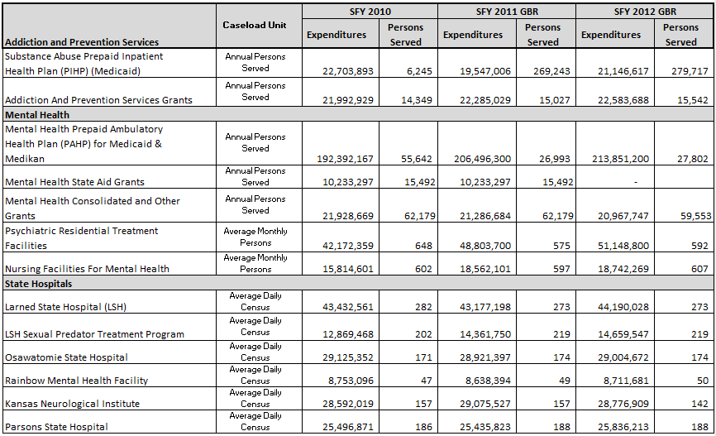
Summary of Expenditures & Persons Served Annual Expenditures in Millions

Slide 23
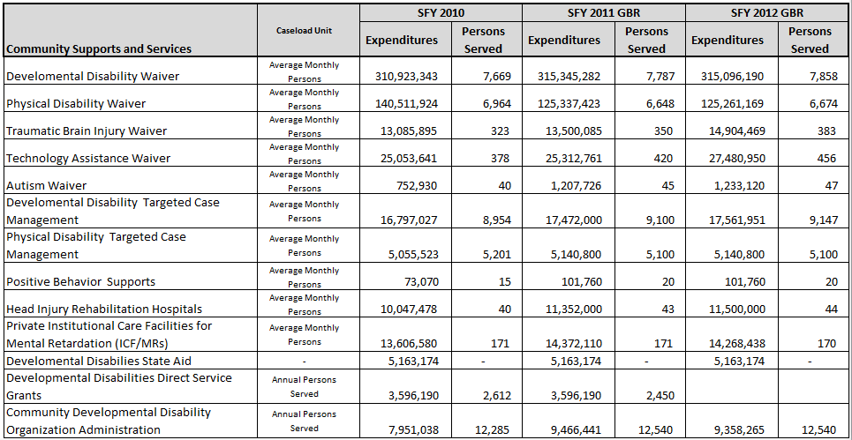
Summary of Expenditures & Persons Served Annual Expenditures in Millions

Slide 24
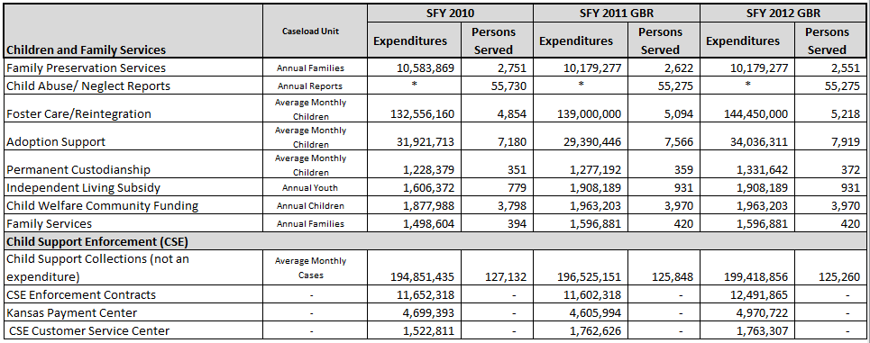
Summary of Expenditures & Persons Served Annual Expenditures in Millions
* Expenditures for child abuse/neglect investigations are included in other budget categories

Slide 25
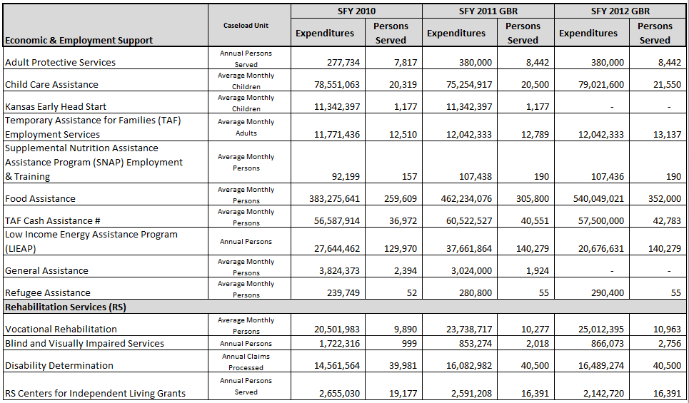
Summary of Expenditures & Persons Served Annual Expenditures in Millions
# - FY 2011 includes one-time ARRA funding

